Slide 1
The Neuroidal Model by Leslie Valiant
Nishanth Dikkala
March 13, 2020

Slide 2
Goal
Feasible computational model of brain which also performs learning
Theory to explain some fundamental capabilities of brain
Memorization
A central challenge: a concrete formulation
3 aspects to formalize
Functions to be computed
Model of computation
Algorithms
Proposed model should satisfy biological constraints

Slide 3
Some Biological Constraints
Pyramidal cells ~ ${10}^{10}$
No new neurons after birth
Believed that no new connections are made among neurons during lifetime
Primary mechanism for learning is weight change
Certain areas designated as sensory areas – process information from senses.
Highly uniform physiology of cortex
Some other quantitative constraints..

Slide 4
The Model of Computation

Slide 5
The Neuroidal Model – Neuroidal Tabula Rasa (NTR)
G – directed graph G = (V,E), |V|=n
Each vertex $i$ represents a neuroid
W = set of edge weights
X = set of modes for a neuroid
Consist of state $q$ and threshold $T$
$δ$ = mode update fn
$λ$ = weight update fn
G can have bidirectional edges.
$$f_{i}$$
$$i$$
$$w_{k}$$

Slide 6
Working of a Neuroid
Timing
discrete time steps 0,1,2,…
All neuroids have synchronized identical clocks
Not too unrealistic biologically
Activation $w_{i}= \sum_{k firing}{w_{ki}}$
$δ\left(s_{i},w_{i}\right)=s_{i}′$ (mode update) $λ\left(s_{i},w_{i},w_{ji},f_{j}\right)=w_{ji}′$ (weight update)
Firing: $f_{i}=1$if $w_{i}≥T_{i}$.
Instantaneous and stops firing by end of next time step
States are denoted by strings in algorithms. e.g. AR = available relay on firing, ‘F’ appended at end, i.e. AR $→$ ARF
Firing transitions (e.g. AR $→$ ARF) always happen if threshold conditions met.
$$f_{i}$$
$$w_{i}= \sum_{k firing}{w_{ki}}$$
$$i$$
$$w_{k}$$

Slide 7
The Neuroidal Model
Given above, two things remain:
Initial Conditions (IC):
Starting weights, states and thresholds of all neuroids
Input Sequence (IS):
Peripherals which connect to external sensors. Connect to certain base neuroids.
IS specifies timing of firing of the base neuroids controlled by peripherals

Slide 8
The Functions to be Computed

Slide 9
Formalizing Cognitive Function
Many different schools of thought
Difficult to describe total behavior in full complexity
Difficult to decompose into simpler constituents
Mathematical description of mental faculties – centuries old challenge
Boolean algebra
Useful starting point
Discrete representations
Actual implementation “fuzzy/soft”
Conjunctions, disjunctions, DNFs

Slide 10
Formalizing Cognitive Function: Knowledge Representation
Positive Knowledge Representations:
Each neuroid corresponds to a semantic item
Several neuroids represent single item.
Only those new items added to memory which are experienced.
Hierarchical – high level items represented as Boolean functions of lower-level items e.g. yellow car
Graded – only approximate Boolean functions represented
Semantic item $x ≡$ set of neuroids $\tilde{x}$ (r per item)

Slide 11
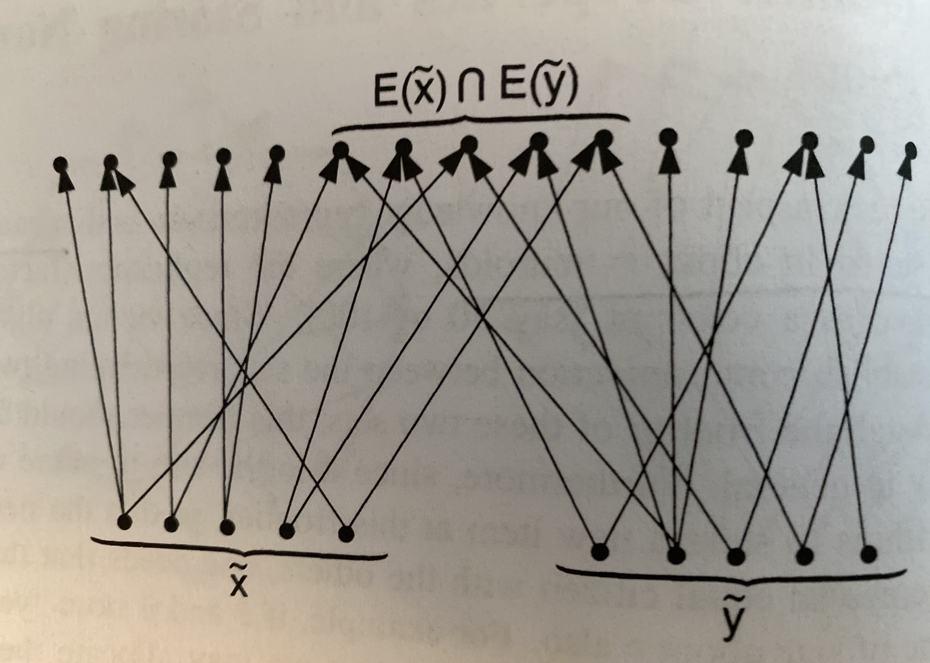
Desired Properties from G
What do we need from G to enable a viable system for cognitive functions according to our knowledge representation model?
All algos in the model are vicinal
Communication between two items not directly connected happens via common neighbors
$E\left(\tilde{x}\right)$ = nodes connected to at least 1 neuroid in $\tilde{x}$.
Frontier: $E\left(\tilde{x}\right)∩E(\tilde{y})$ – will be used to represent $x \bigwedge{y}$
3 properties required
Non-empty frontiers
Hashing property: frontier is not already allocated to another item
Sufficiently large set of relay nodes: for any two items want some nodes which connect them in both directions

Slide 12
Desired Properties from G
All 3 can be achieved approximately using random graphs when $N≫r$. Directed $G(n,p)$ with $p= \frac{\sqrt{μ}}{\sqrt{rN}}$
3 properties required
Sufficiently large frontier: $\left|E\left(\tilde{x}\right)∩E\left(\tilde{y}\right)\right|≈r$
Hashing: w.h.p., nodes in $E\left(\tilde{x}\right)∩E(\tilde{y})$ aren’t assigned to some other $\tilde{z}$.
Sufficiently large set of relay nodes: Given $\tilde{x}$ and $\tilde{z}$ $E\left[\#nodes in \tilde{z} with≥1 common neighbor with nodes of\tilde{x}\right]≈μr$
Pristine conditions assumptions:
Number of neuroids representing an item is exactly r
Edges towards neuroids not yet allocated are present with equal probability independently.

Slide 13
Desired Properties from G
Sufficiently large frontier property
Given any node i not in $\tilde{x}$ or $\tilde{y}$, $\operatorname{Pr}\left[i connected to at least 1 of \tilde{x} and 1 of\tilde{y}\right]={\left(1−{\left(1−p\right)}^{r}\right)}^{2}$ $≈r^{2}p^{2}=O\left(\frac{r}{N}\right)$ $⇒E\left[size of frontier\right]=O(r)$

Slide 14
Formalizing Cognitive Functions
Classifying Learning Tasks
 | Supervised | Unsupervised
Memorization and Deductive Learning | Supervised Memorization | Unsupervised Memorization
Inductive Learning | Supervised Inductive Learning | Unsupervised Inductive Learning

Slide 15
Algorithms

Slide 16
Unsupervised Memorization
Informal Task: following presentation of an input, remember it so that neuroidal system recognizes future presentations of the same input. Main challenge – storage allocation
Formal Task: Input $x$ with semantic attributes $x_{1},…,x_{n}$ represented in NTR by $\tilde{x_{1}},…,\tilde{x_{n}}$ . Allocate new set of neuroids$\tilde{z}$ that corresponds to $x$ and in future $\tilde{z}$ fires iff $\tilde{x_{1}},…,\tilde{x_{n}}$ all fire.
Start simple: $\tilde{x_{1}},\tilde{x_{2}}$
Allocate the frontier $E\left({\tilde{x}}_{1}\right)∩E({\tilde{x}}_{2})$

Slide 17
Unsupervised Memorization
First attempt
All nodes in frontier $E\left({\tilde{x}}_{1}\right)∩E({\tilde{x}}_{2})$ start in state Available Memory (AM). Incoming weights are all 1, threshold is infinite.
STEP 0: Prompt: ${\tilde{x}}_{1},{\tilde{x}}_{2}$ $\left\{q_{i}=AM, w_{i}≥2\right\}→\left\{q_{i}=UM, T_{i}=w_{i}, if f_{j}=0 then w_{ji}=0\right\}$

Slide 18
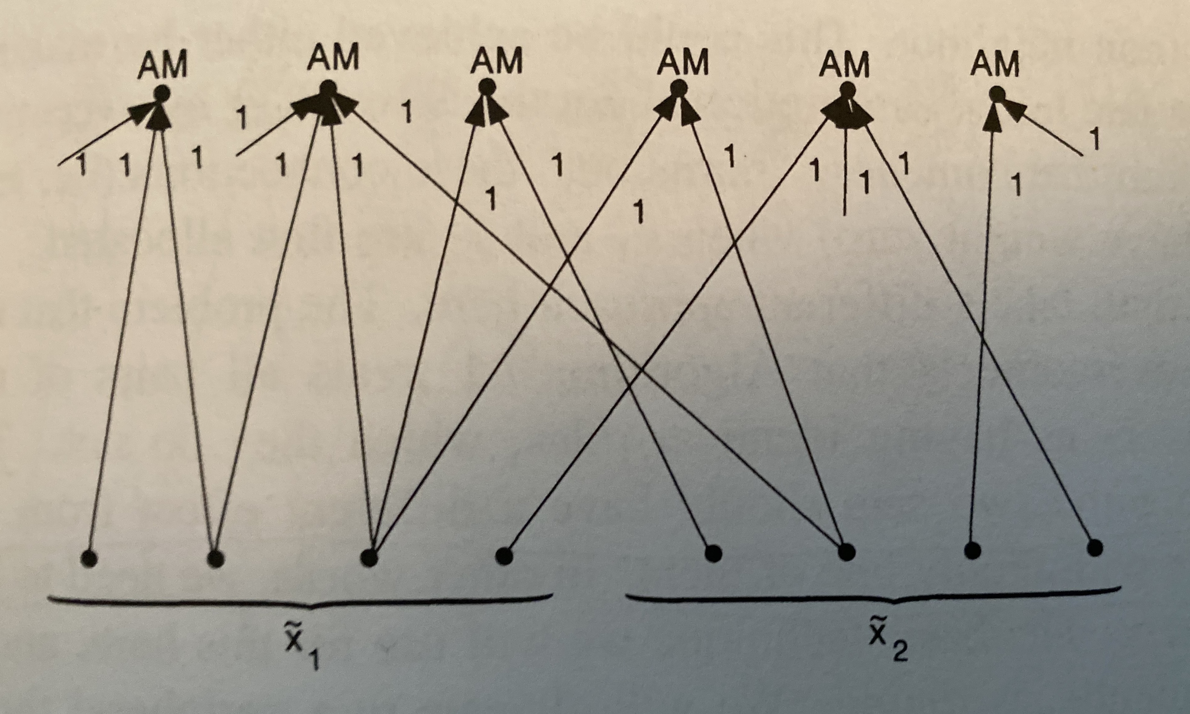
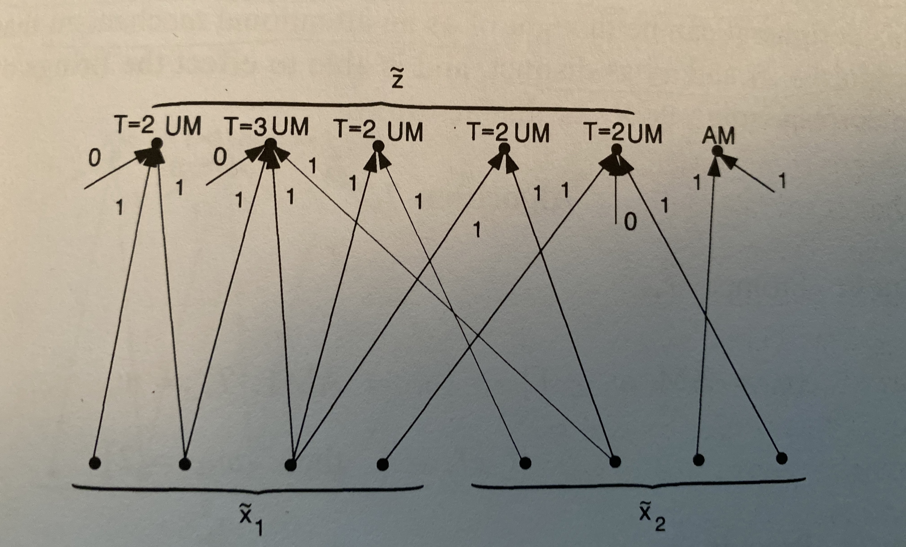
Unsupervised Memorization
STEP 0: Prompt: ${\tilde{x}}_{1},{\tilde{x}}_{2}$ $\left\{q_{i}=AM, w_{i}≥2\right\}→\left\{q_{i}=UM, T_{i}=w_{i}, if f_{j}=0 then w_{ji}=0\right\}$
Issue: Node connected to 2 of ${\tilde{x}}_{1}$ and 0 of ${\tilde{x}}_{2}$ will also change state. redundancy

Slide 19
Unsupervised Memorization
Algorithm without redundancy
STEP 0: Prompt ${\tilde{x}}_{1}$ $\left\{q_{i}=AM, w_{i}≥1\right\}→\left\{\begin{aligned}q_{i}=AM1,T_{i}=w_{i}, \\ if f_{j}=1, then w_{ji}=2\end{aligned}\right\}$
STEP 1: Prompt ${\tilde{x}}_{2}$ $\left\{q_{i}=AM1, w_{i}≥1\right\}→\left\{\begin{aligned}q_{i}=UM, T_{i}=T_{i}+w_{i}, \\ if f_{j}=0 and w_{ji}=1, then w_{ji}=0 \\ if f_{j}=0 and w_{ji}=2,then w_{ji}=1\end{aligned}\right\}$ $\left\{q_{i}=AM, w_{i}<1\right\}→\left\{T_{i}=∞, w_{ji}=1 ∀j\right\}$

Slide 20
Supervised Memorization
Task: Given presentation of an input and a label for the input, associate the neuroids representing the input to the neuroids representing the label.
Formal task: Given input $x$ with semantic attributes $x_{1},…,x_{n}$ represented in NTR by $\tilde{x_{1}},…,\tilde{x_{n}}$ and a label $\tilde{z}$, associate ${\tilde{x}}_{1}∧ {\tilde{x}}_{2}…∧{\tilde{x}}_{n}$ with $\tilde{z}$. In future, whenever $\tilde{x_{1}},…,\tilde{x_{n}}$ all fire, $\tilde{z}$ must fire.

Slide 21
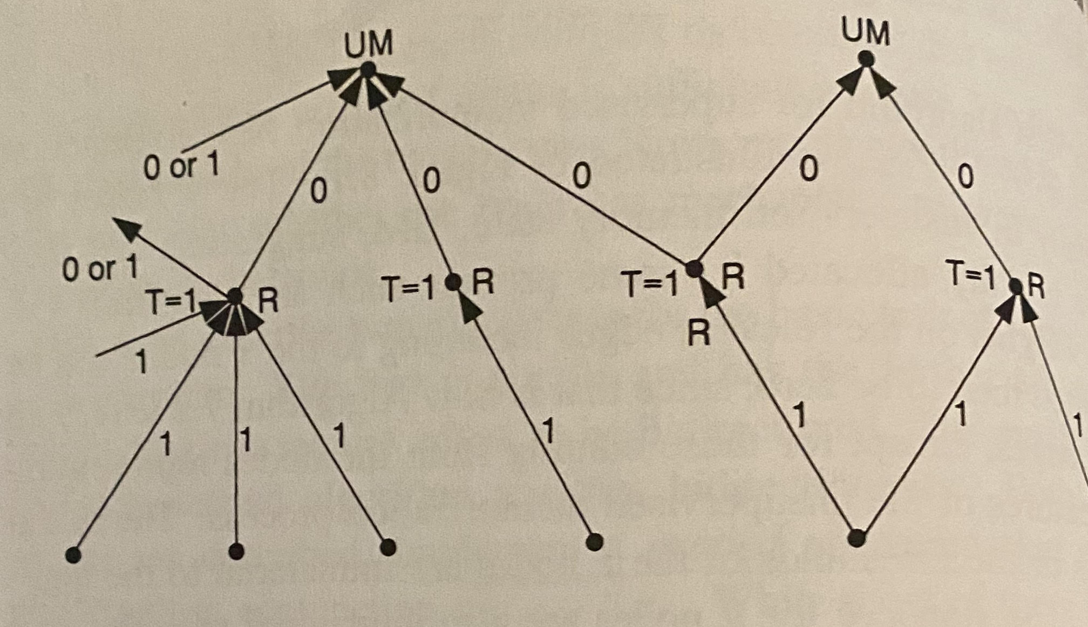
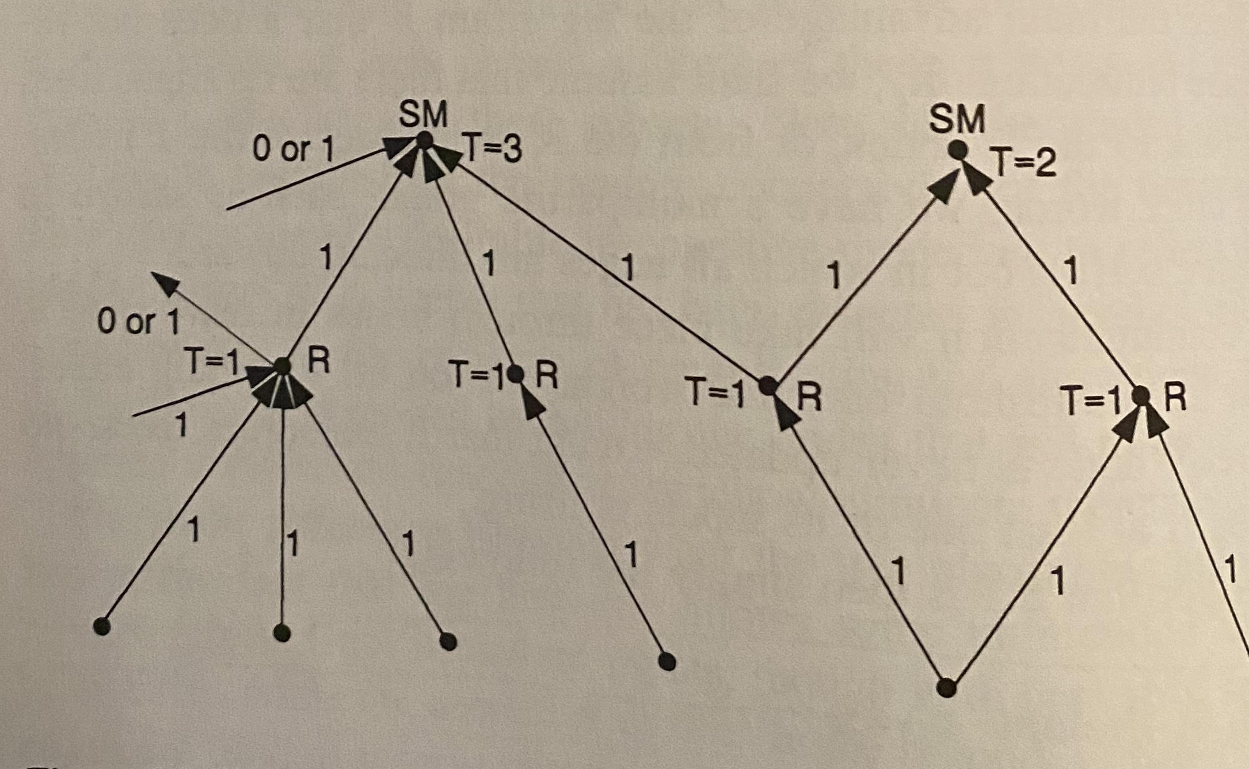
Supervised Memorization
First approach
Assume relay nodes have weight 1 and threshold 1. so relay activations instantaneously.
STEP 0: Prompt ${\tilde{x}}_{1},…,{\tilde{x}}_{n},\tilde{z}$ $\left\{q_{i}=UMF\right\}→\left\{q_{i}=UM1, if f_{k}=1, then w_{ki}=1\right\}$
STEP 1: Prompt ${\tilde{x}}_{1},…,{\tilde{x}}_{n}$ $\left\{q_{i}=UM1\right\}→\left\{q_{i}=SM, if f_{k}=1, then w_{ki}=T_{i}/w_{i}\right\}$
Issue: other nodes connected to relay nodes can trigger them in future. Small prob. of occurring.

Slide 22
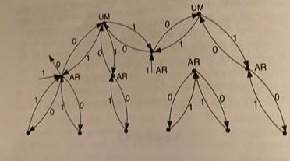
Supervised Memorization
Robust Approach – use bi-directional edges.
Each relay node starts in Available Relay (AR). Initial T=$∞$. incoming weights all 1, outgoing weights all 0.
STEP 0: Prompt ${\tilde{x}}_{1},{\tilde{x}}_{2},…,{\tilde{x}}_{n},\tilde{z}$ $\left\{q_{k}=AR,w_{k}≥2\right\}→\left\{q_{k}=AR1F\right\}$ $\left\{q_{i}=UMF\right\}→\left\{q_{i}=UM1\right\}$
STEP 1: Prompt $\tilde{z}$ $\left\{q_{k}=AR1F,w_{k}≥1\right\}→\left\{q_{k}=AR2\right\}$ $\left\{q_{k}=AR1F, w_{k}<1\right\}→\left\{q_{k}=AR\right\}$ $\left\{q_{i}=UM1F\right\}→\left\{q_{i}=UM2, if f_{k}=1 then w_{ki}=1\right\}$

Slide 23
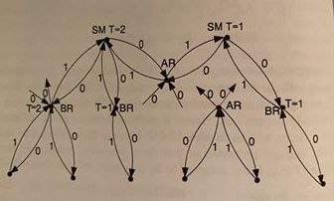
Supervised Memorization
STEP 2: Prompt ${\tilde{x}}_{1},{\tilde{x}}_{2},…,{\tilde{x}}_{n}$ $\left\{q_{k}=AR2,w_{k}≥1\right\}→\left\{\begin{aligned}q_{k}=BR,T_{k}=w_{k}, \\ if f_{l}=0 then w_{lk}=0\end{aligned}\right\}$ $\left\{q_{k}=AR2, w_{k}<1\right\}→\left\{q_{k}=AR,w_{lk}=0 ∀ l\right\}$ $\left\{q_{i}=UM2\right\}→\left\{q_{i}=UM3\right\}$
STEP 3: Prompt ${\tilde{x}}_{1},{\tilde{x}}_{2},…,{\tilde{x}}_{n}$ $\left\{q_{i}=UM3\right\}→\left\{q_{i}=SM,T_{i}=w_{i}\right\}$ (required as separate step due to threshold update)

Slide 24
Supervised Inductive Learning
Through examples, extrapolate to unseen inputs.
PAC-Learning model
Answer is an approximation to correct answer most of the time
Probability of correctness and accuracy improve with more samples
A simple example: Learning conjunctions
Given Boolean variables $x_{1},x_{2},…,x_{n}$, the true function is a conjunction of a subset of them (e.g. $f\left(x\right)=x_{1}x_{5}x_{8}$). Input: examples $\left(x^{\left(i\right)},f\left(x^{\left(i\right)}\right)\right)$. (no noise setting) Output: Learnt $\hat{f}$ such that w.p >9/10 $\hat{f}=f$.

Slide 25
Supervised Inductive Learning
Simple elimination algorithm
On first positive example, perform analog of SM – to remember all items involved in the example. The nodes $\tilde{z}$ are in state SC (Supervised Conjunction) after this step.
On every further positive example perform the following: STEP: Prompt $\left\{{\tilde{x}}_{j}| x_{j} true for the example\right\}$ $\left\{q_{i}=SCF\right\}→\left\{q_{i}=SC, T_{i}=w_{i}, if f_{k}=0 then w_{ki}=0\right\}$

Slide 26
Supervised Inductive Learning
Learning linear threshold functions
$f: {\left\{0,1\right\}}^{n}→\left\{0,1\right\},$ $f\left(x_{1},x_{2},…,x_{n}\right)=1 iff$ $u_{1}x_{1}+u_{2}x_{2}+…+u_{n}x_{n}≥θ.$

Slide 27
Supervised Inductive Learning
Perceptron Algorithm:
Start with $v_{i}=0$ for all $i$. Threshold $θ=1$.
Given an example $(e_{1},…,e_{n})$ and label $l$: if $l$ agrees with $\sum{v_{i}e_{i}−θ}$ then do nothing, else $∀ i, v_{i}=v_{i}+l ⋅e_{i}$ $θ=θ+l$
Easy to implement using neuroids.

